Slide 1
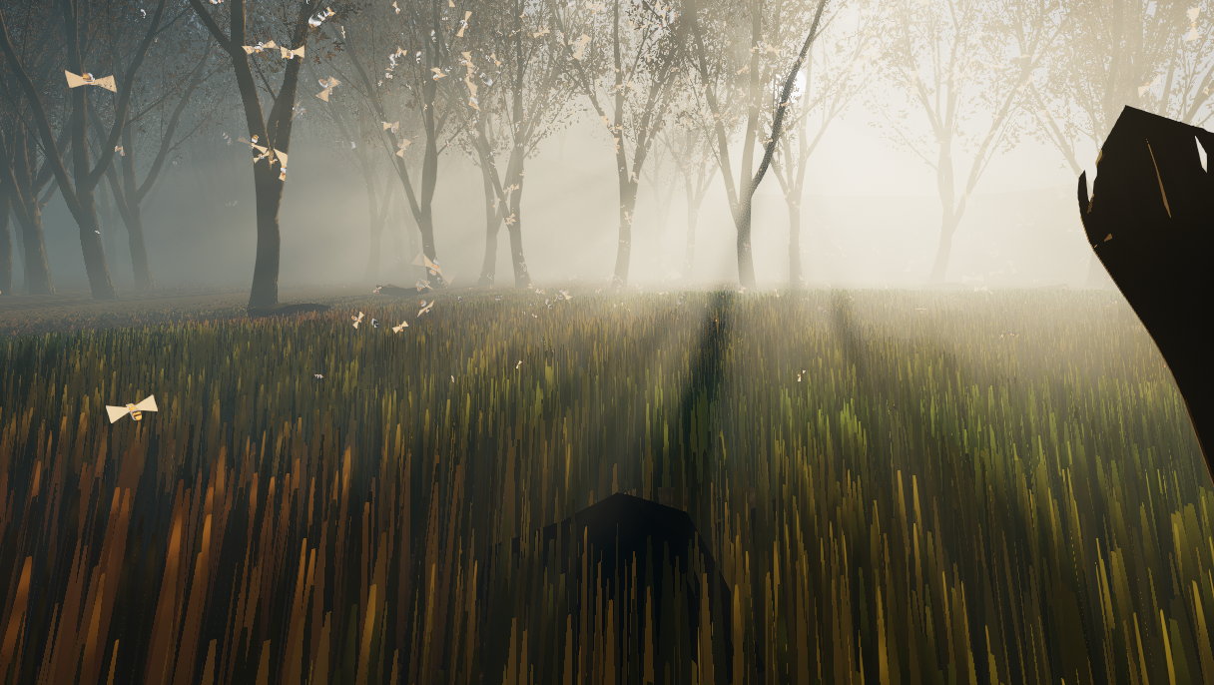
Shaders
Luca Türk, Samuel Knöthig, Sven Lüpke

Slide 2
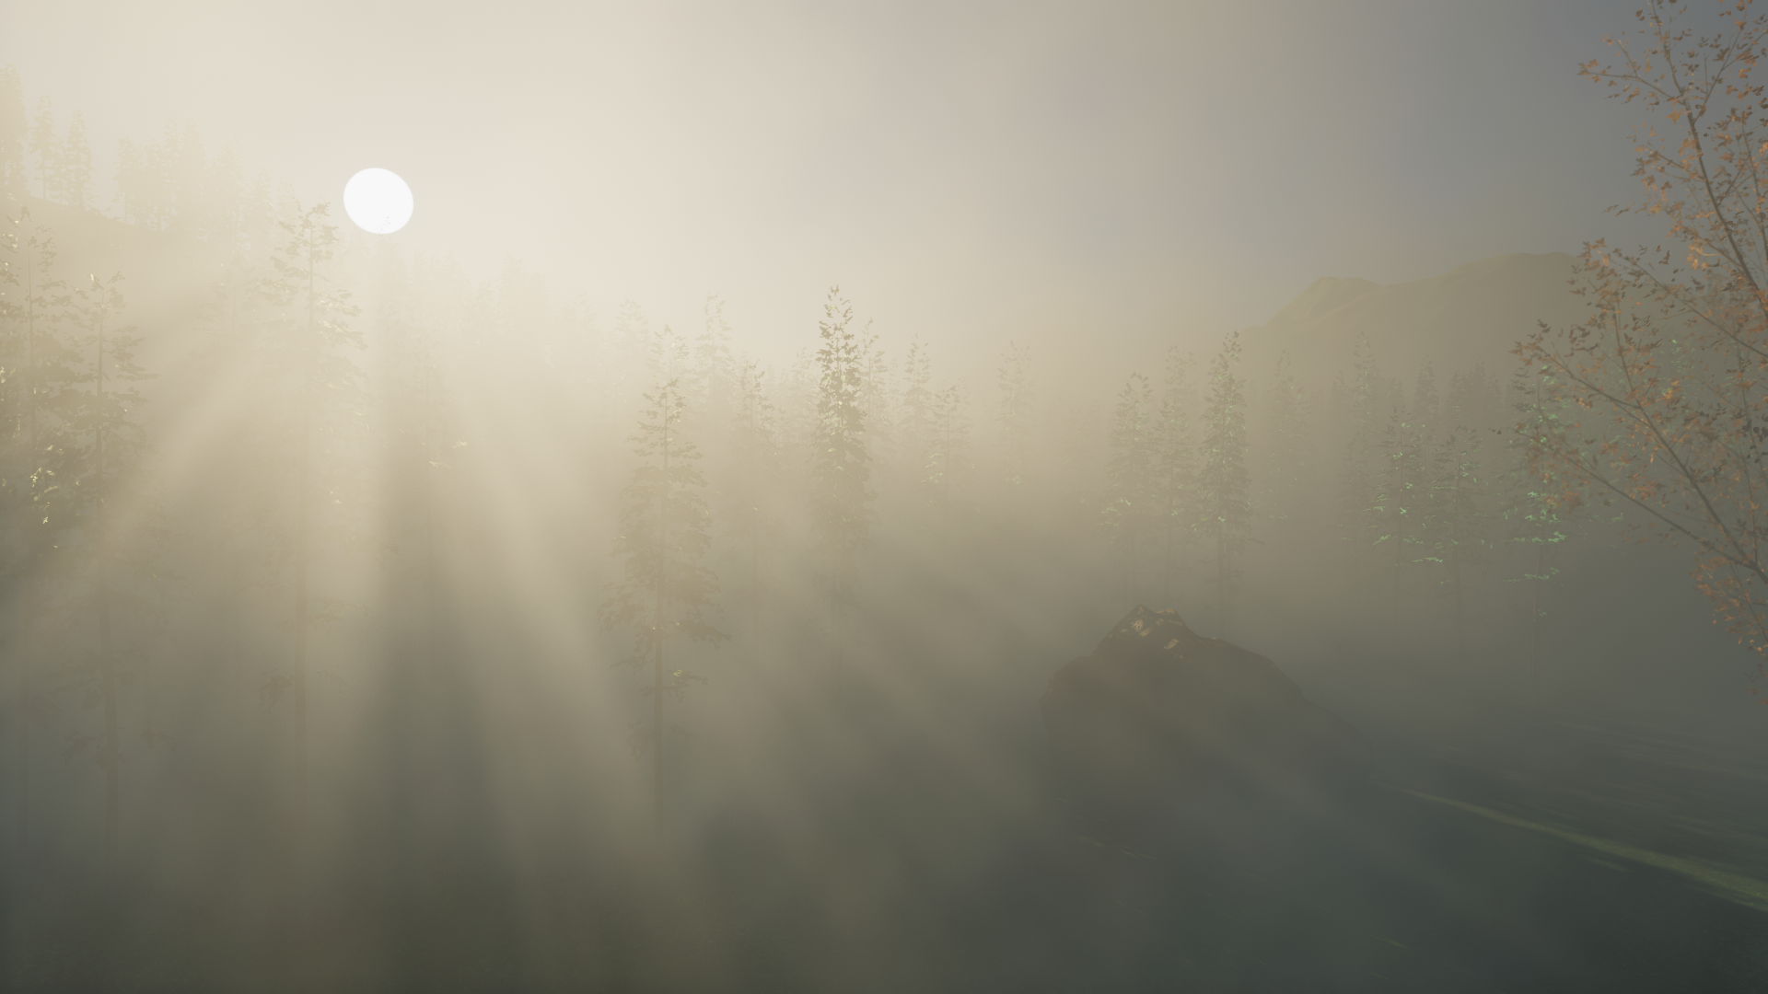
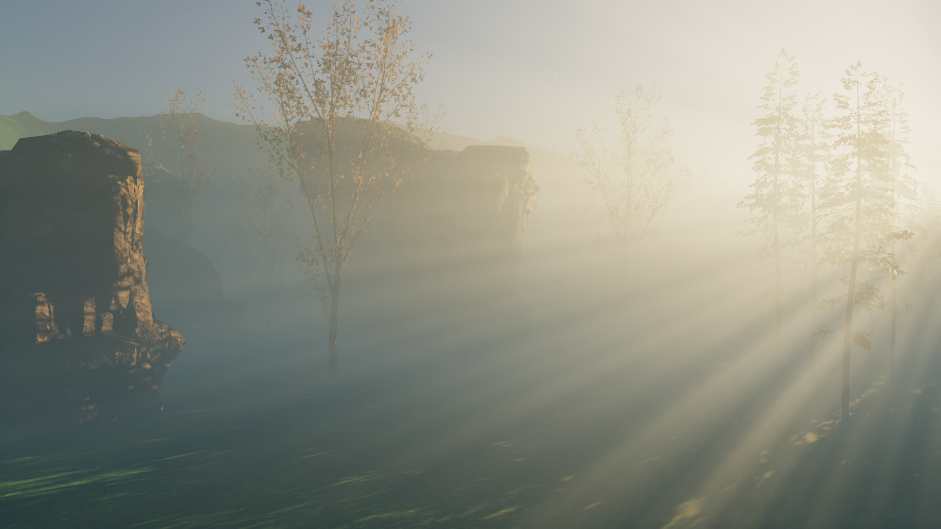
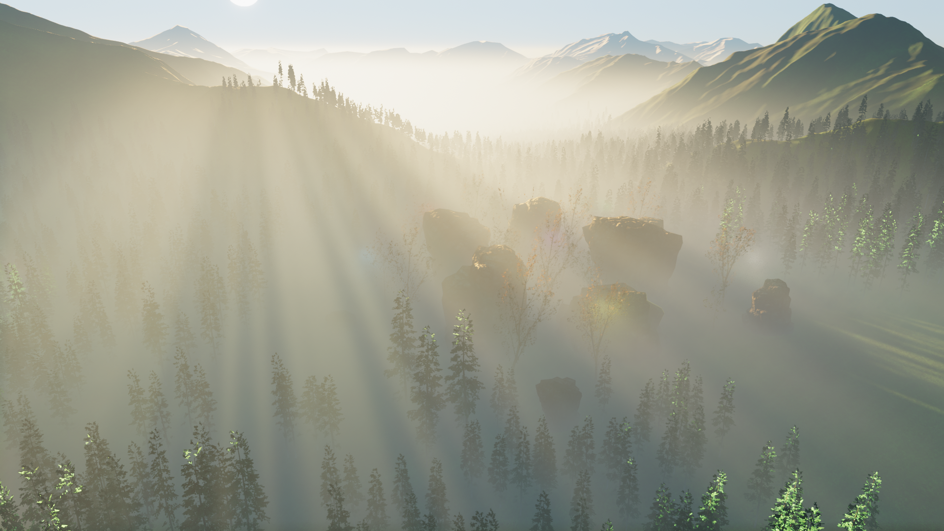
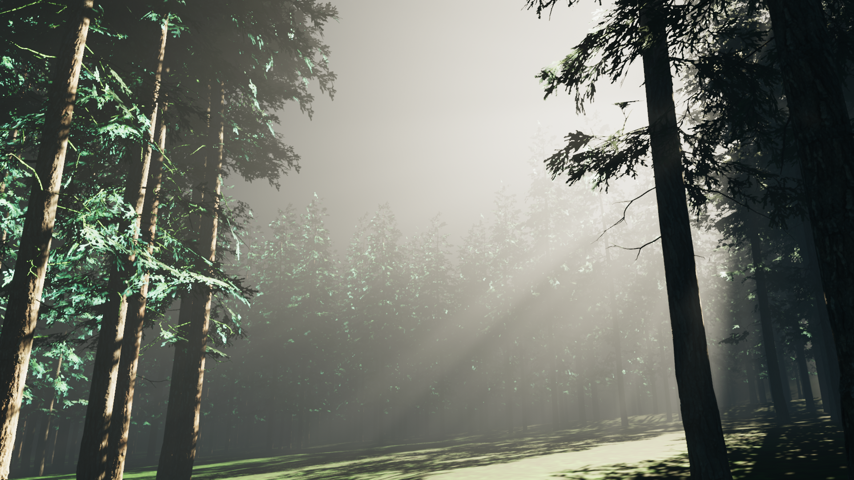
Physically Based Volumetric Fog and Atmosphere
Sven Lüpke

Slide 3
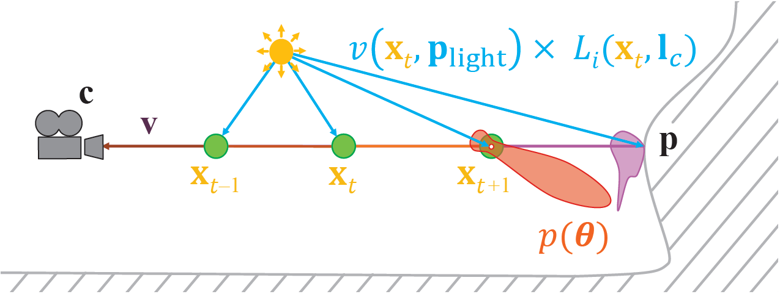
Light Scattering Theory [Akine-Möller18]
$$L_{i}\left(c, −v\right)=T_{r}\left(c, p\right)L_{o}\left(p,v\right)+\int_{t=0}^{\left\|p−c\right\|}{T_{r}\left(c, c−vt\right)L_{scat}\left(c−vt, v\right)σ dt}$$

Slide 4

Implementation
Frustum oriented volume [Wronski14]
240x135x96
In-scattering in RGB
Scattering coefficient in Alpha
Exponential depth distribution [Sousa16]
Animated perlin noise
Covers scene up to 900 units from camera
Analytic pixel shader fog [Quilez10] beyond 900 units
4 passes:
Compute density and lighting at each sample position (Compute Shader)
Temporal Filter (Compute Shader)
Raymarch through volume (Compute Shader)
Upscale Fog and apply to scene using depth (Pixel Shader)

Slide 5
Temporal Supersampling
Use previous frames to increase sample count
Jitter sample positions using Halton sequence(2, 3, 5) [Karis14]
Exponential moving average
Need to compute position in history buffer if camera moves
Neighborhood clamping [Salvi16] to avoid ghosting on moving lights
Raymarch
Compute Density and Lighting
Average and clamp
History Buffer
8%
92%

Slide 6
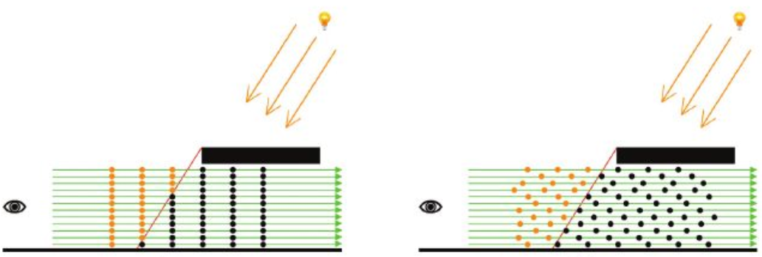
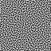
Dithering
Offset sample depth using blue noise [Vos14][Bauer19]
Better sample distribution
Helps against flickering caused be neighborhood clamping
Dither sample positions during upscaling as well [Bauer19]

Slide 7
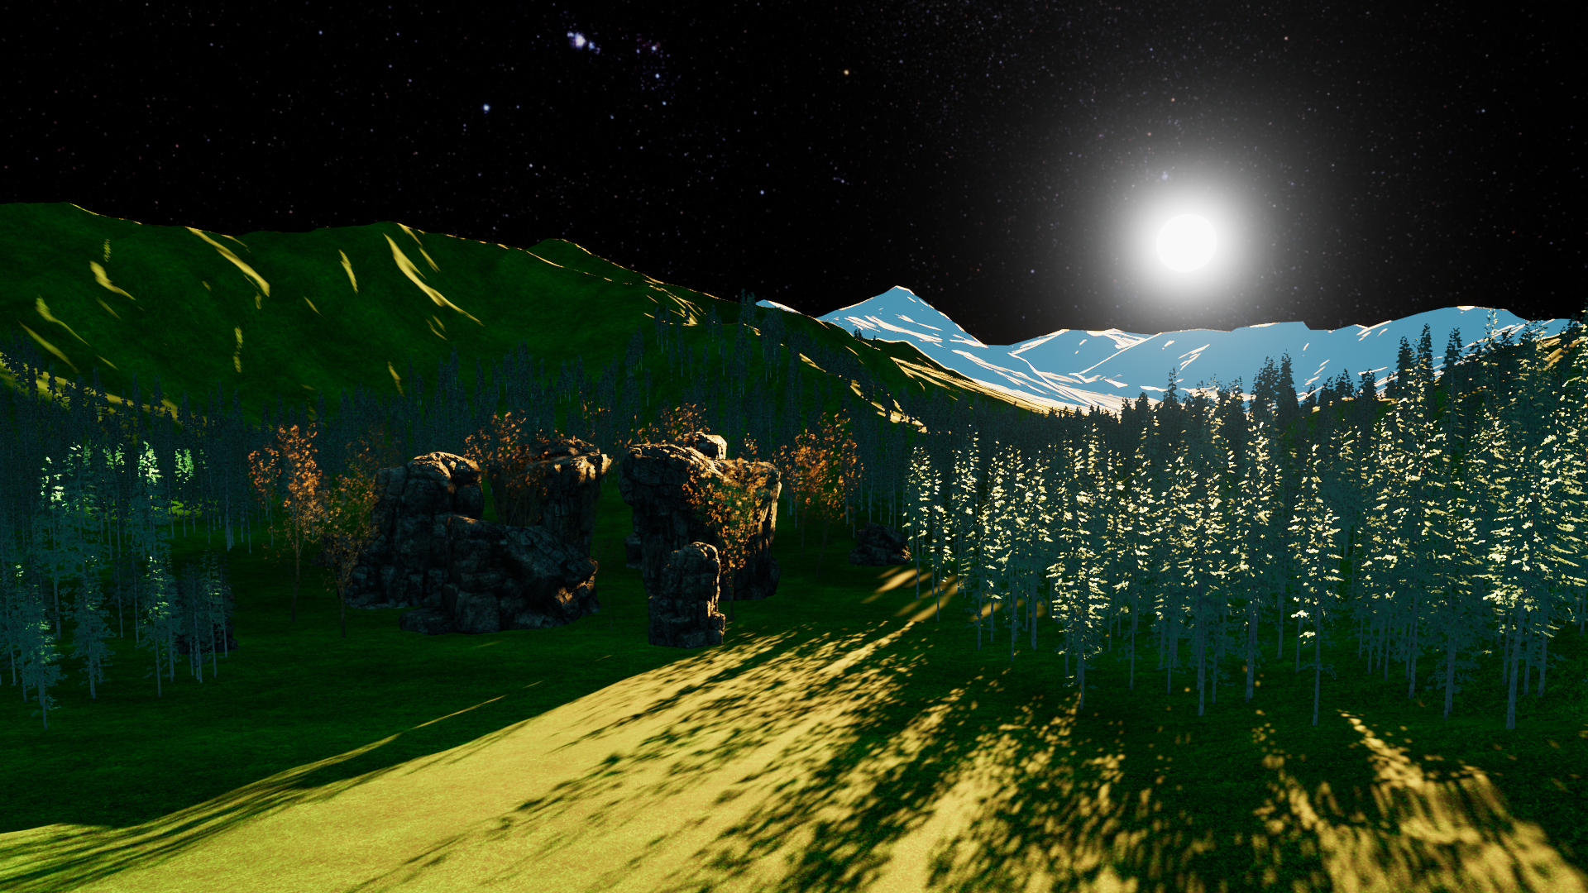
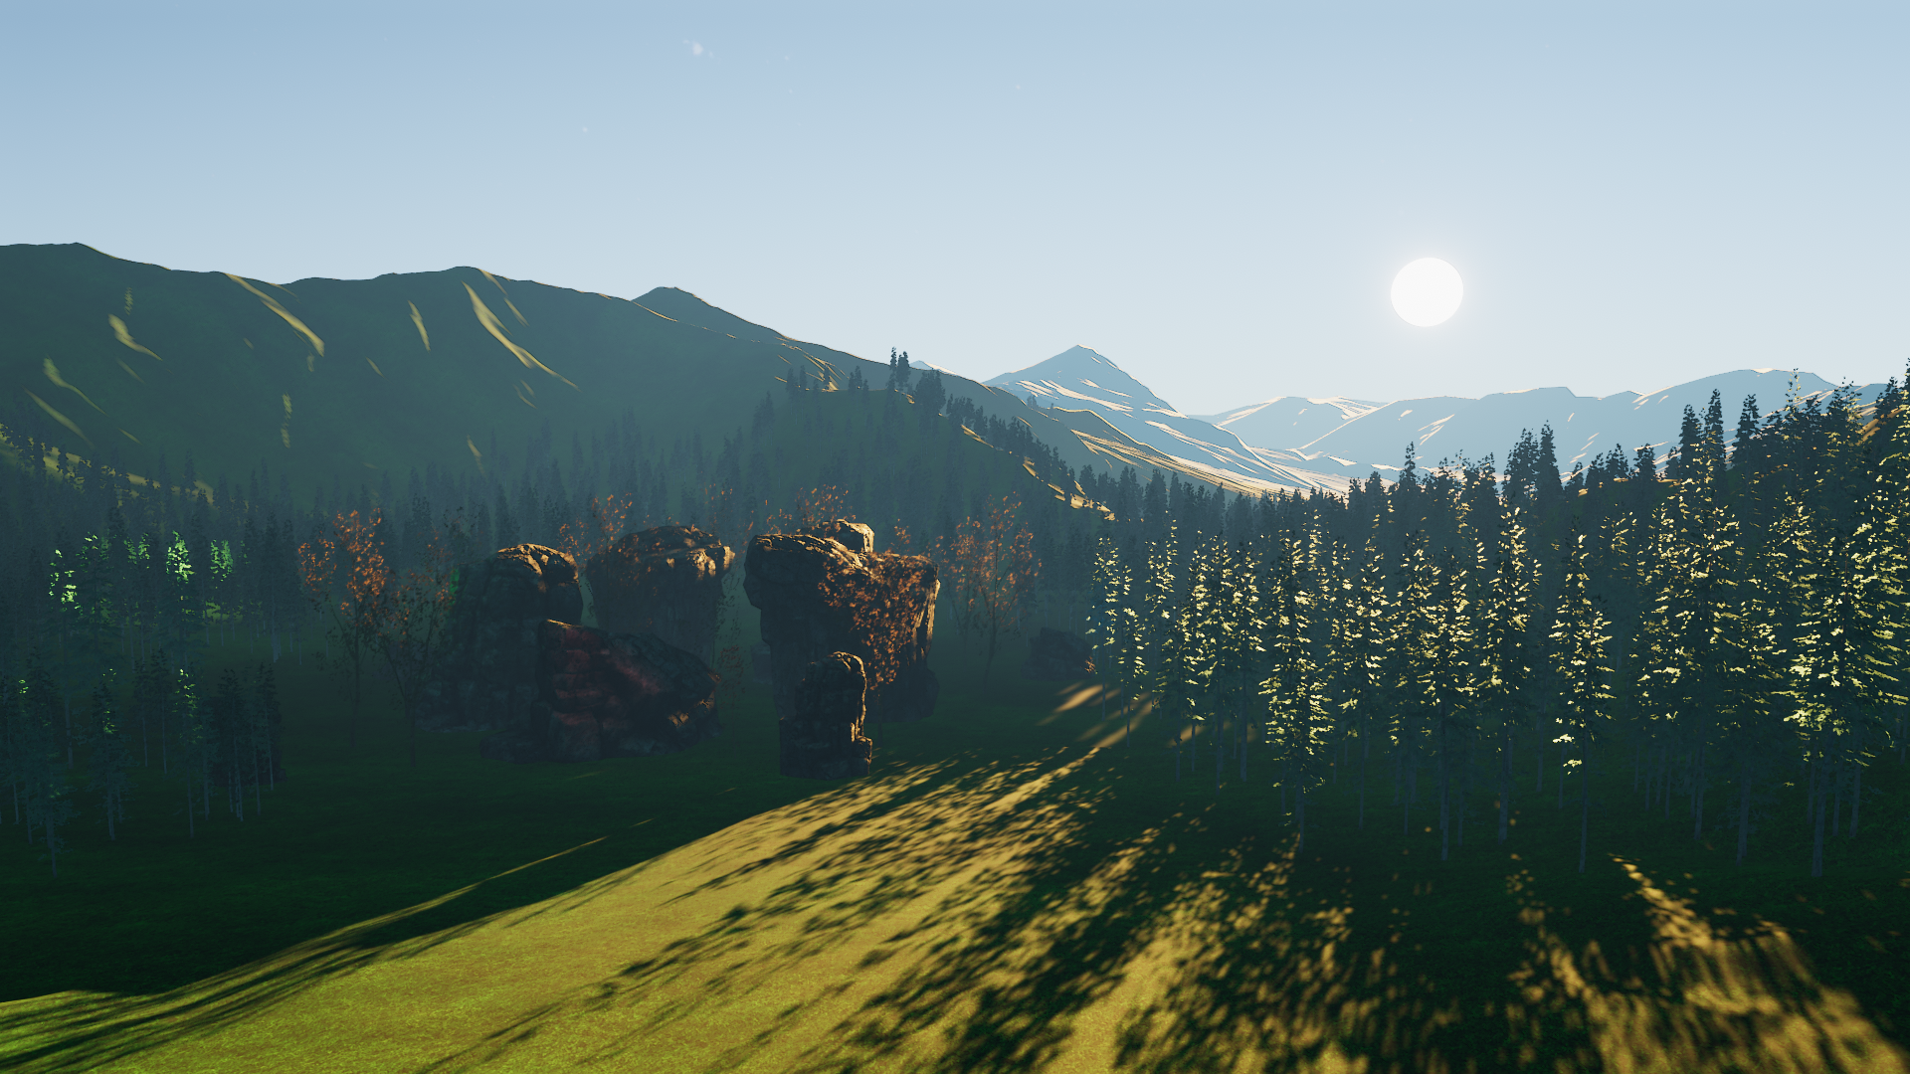
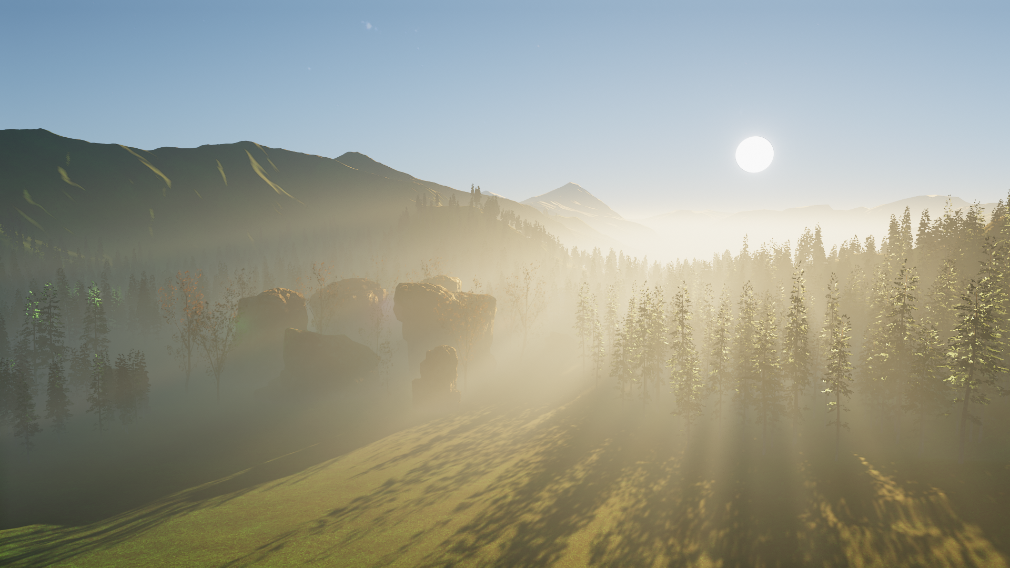
Atmosphere
Uses stripped down version of the fog shaders
No shadows, dithering and temporal supersampling
Volume resolution: 32x32x32
Scattering coefficient set to (0.25, 0.5, 1)*10⁻⁴
No fog or atmosphere
Atmosphere only
Fog and Atmosphere

Slide 8
Performance
Fog + Atmosphere
Measured on a GTX 1050
Without point lights: 3.5 ms
With 8 point lights: 4.5 ms

Slide 9
Grass Shader – Live Demo

Slide 10
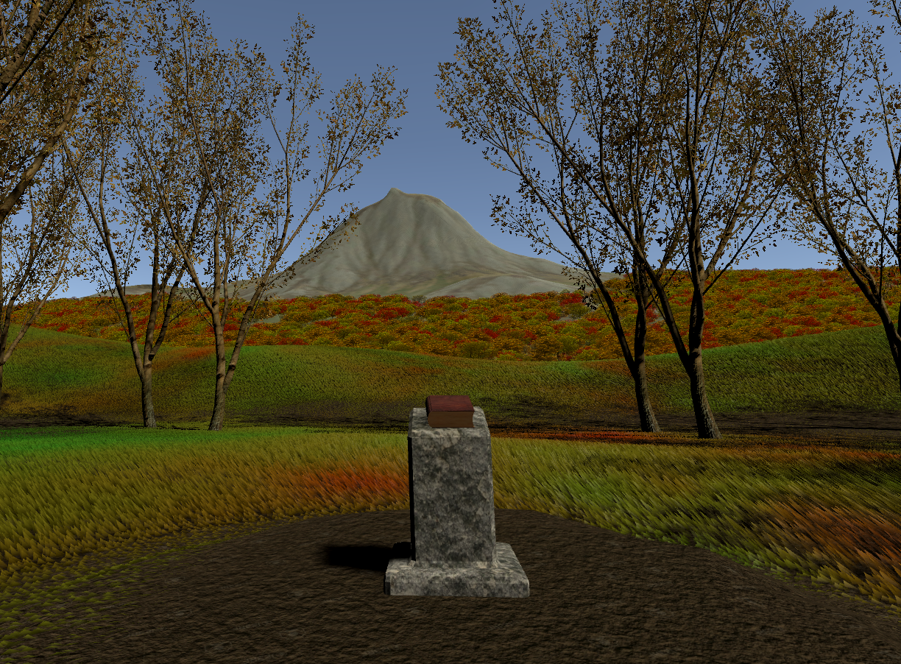
Vegetation Luca Türk

Slide 11
Grass Shader – General
Generate grass geometry in tessellation and geomety stage
Allow artist to pass properties such as height, color distribution and wind displacement
Collide grass blades with player and other specified objects

Slide 12
Grass Shader – Tessellation
Create additional ground verticies for geometry shader to work on, effectively increasing grass density
Optimizations: Tessellation fractors decrease with distance to player, and input verticies are frustum culled

Slide 13

Grass Shader – Geometry
Initially, a single grass blade was added in the centre of the input triangle.
But, a lot of tessellation required for the dense grass look.
==> Add multiple blades for each triangle

Slide 14

Grass Shader – Geometry
Grass blades are constructed out of four verticies, which allows for less pointy looking blades, by pushing down the top verticies.

Slide 15
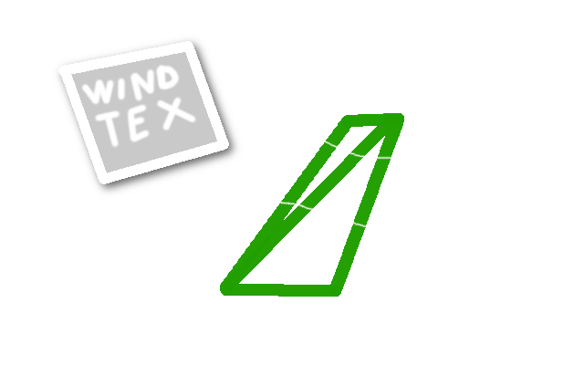
Grass Shader – "External" Influences
Grass Blades are influenced by wind, achieved by a displacement texture applied to the top vertex positions.

Slide 16
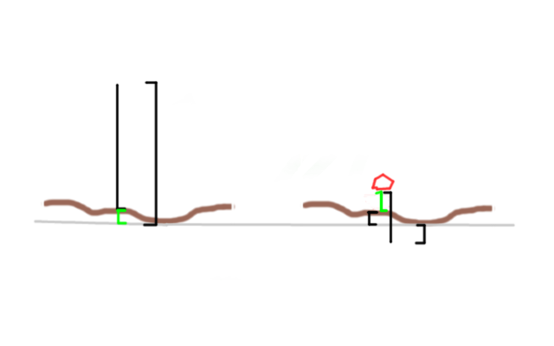
Grass Shader – "External" Influences
Additionally grass will collide with players or other objects, and bend away.

Slide 17
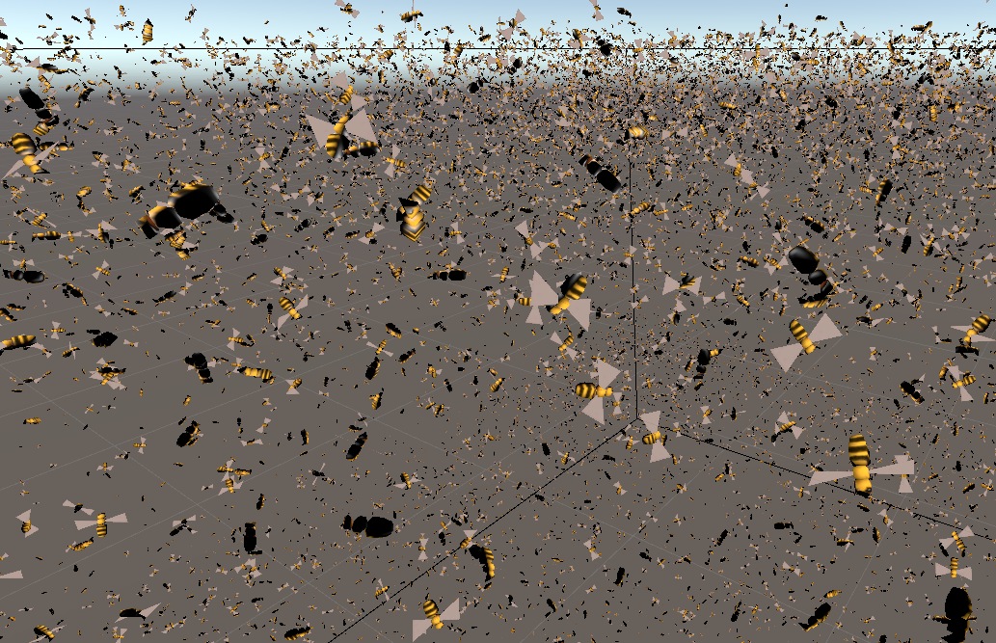
Boids (Bird-like objects) Samuel Knöthig

Slide 18
Boids (Bird-like objects)
Simulate birds by calculating the desired movement-vector of each separate particle
Calculated via a compute shader
Drawn using DrawMeshInstancedIndirect with appropiate shader

Slide 19
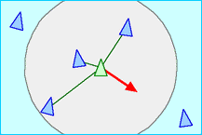
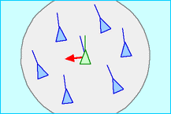
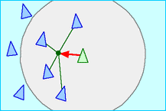
Boids (Theory)
Separation
Alignment
Cohesion

Slide 20
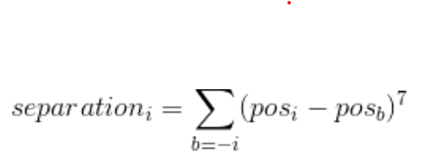
Boids (Separation)
Avoid crashing into other boids and obstacles
Steer away from other boids and the walls of the boundry-box
Increase impact of desire with decreasing distance

Slide 21
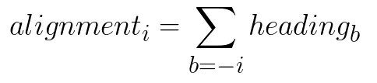
Boids (Alignment)
Try to match speed with other boids
Creates a more "stable" look

Slide 22
Boids (Cohesion)
Fly towards other boids
But not too close

Slide 23
Boids (Additional stuff)
Finetune formulas with (a lot) of constants
Rotate boids towards their flying direction
Put everything into a prefab with some constants exposed (e.g. size)
Draw meshes at the position of the particles

Slide 24
References
[Wronski14] B. Wronski: Volumetric Fog: Unified compute shader based solution to atmospheric scattering, SIGGRAPH 2014
[Hillaire15] S. Hillaire: Physically Based and Unified Volumetric Rendering in Frostbite, SIGGRAPH 2015
[Bauer19] F. Bauer: Creating the Atmospheric World of Red Dead Redemption 2: A Complete and Integrated Solution, SIGGRAPH 2019
[Vos14] N. Vos: Volumetric Light Effects in Killzone: Shadow Fall, GPU Pro 5, CRC Press 2014
[Akine-Möller18] T. Akenine-Möller, E. Haines, N. Hoffman, A. Pesce, M. Iwanicki, S. Hillaire, Real-Time Rendering, Fourth Edition, CRC Press 2018
[Hillaire16] S. Hillaire: Physically Based Sky, Atmosphere and Cloud Rendering in Frostbite, SIGGRAPH 2016
[Karis14] B. Karis: High Quality Temporal Supersampling, SIGGRAPH 2014
[Salvi16] M. Salvi: An Excursion in Temporal Supersampling, GDC16
[Jimemez16] J. Jimenez: Filmic SMAA, Sharp Morphological and Temporal Antialiasing, SIGGRAPH 2016
[Sousa16] T. Sousa, J. Geffroy: The Devil is in the Details: idTech 666, SIGGRAPH 2016
[Quilez10] https://www.iquilezles.org/www/articles/fog/fog.htm

